Slide 1
UI/UX Worksheet
Project Title:
PetMatch
Team members
6530262 Min Myint Moh Soe
6530289 Sai Oum Maing
6622085 Min Htet
6520102 Aung Bhone Naing
6530198 Heang Mengtry

Slide 2
Day 12

Slide 3
Individual assignment: Create HF prototype (5%)
60 mins
Objective
To be able to use Figma application to create HF prototype of final project.
Instructions
For each team member, use Figma to create HF prototype of a main feature in your final project.
You must use the realistic information and pictures.
Once finished, insert picture, name of creator, annotations, short description of the feature in your worksheet.
Note:
A team is required to have at least 4 main features.
You can insert more slides in the worksheet (if any).

Slide 4


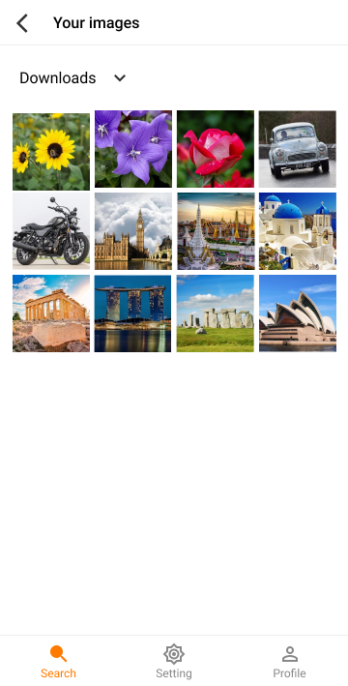
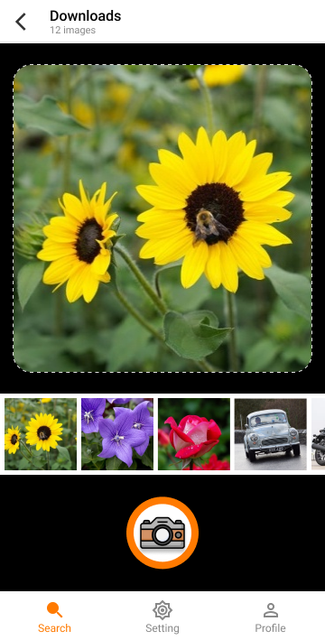
HF prototype of main features (1) (example)
Select desirable album
Select picture for searching
Slide to see other pictures in the album
Select picture from photo album
Click this button to take picture and search
Search menu
Click this button to search by selected picture
User can search by taking a picture
(6615000 John Smith)
User can search by picture in photo album
(6615000 John Smith)

Slide 5
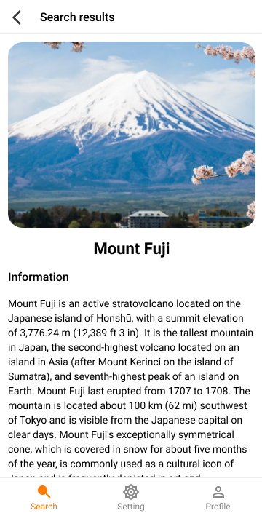
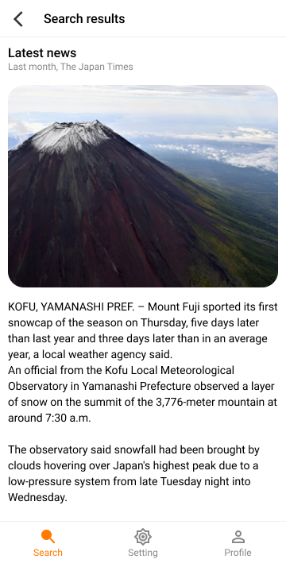
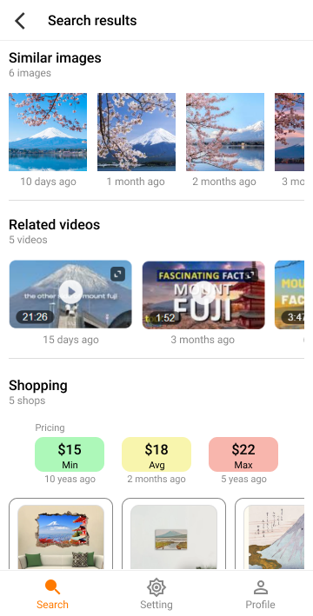
HF prototype of main features (2) (example)
Similar images sorted by date in descending order
Name of searched item
Related videos sorted by date in descending order
Use AI to search, collect, and summarize information, such as origin, history, story, and so on.
Latest news of searched item
Shops that sell searched item. It provides min price, max price, and average price.
Search result
(6615000 John Smith)
Search result
(6615000 John Smith)
Search result
(6615000 John Smith)

Slide 6
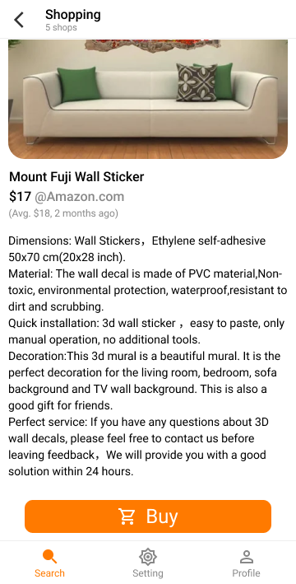
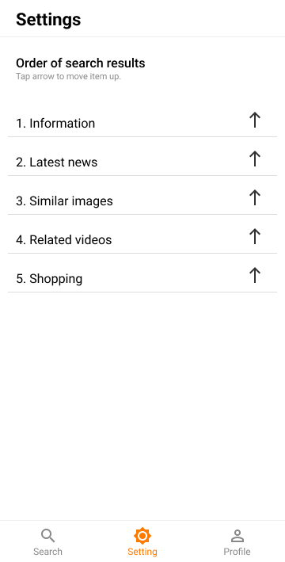
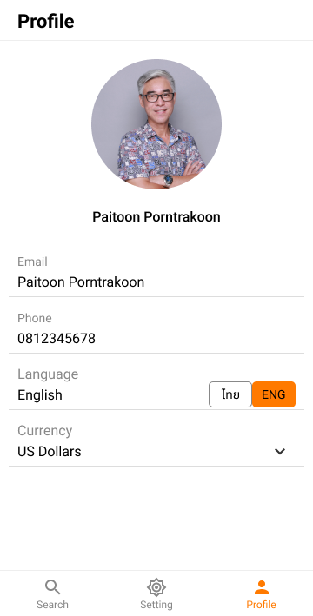
HF prototype of main features (3) (example)
Order of search results
Product information
User profile
Setting menu
Profile menu
Click this button to purchase
Purchasing
(6615000 John Smith)
Setting of the search results
(6615000 John Smith)
User profile
(6615000 John Smith)

Slide 7
Individual assignment: Create HF prototype
Grading Criteria
0 = No submission
1 = HF prototype of a main feature is incomplete or is subjective.
3 = HF prototype of a main feature is complete but is not explained or annotated.
5 = HF prototype of a main feature is complete, clearly explained, and clearly annotated.

Slide 8
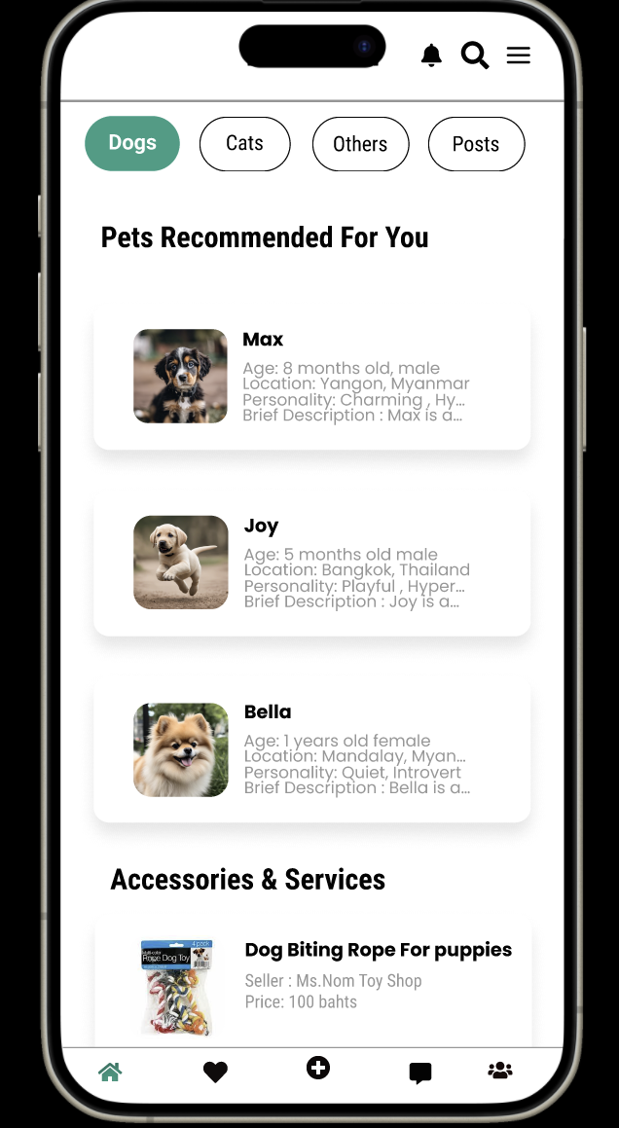
HF prototype of main features (1)
Notifications Button
Search Button
Profile Button
Categories
Pet Details
Product Details
Find Match Button
Create Post Button
Green color used for Current Page
Chat Inbox Button
Friends and Followers Button
Short description
(Creator ID and Name)
Home Page
(Min Myint Moh Soe_6530262)

Slide 9
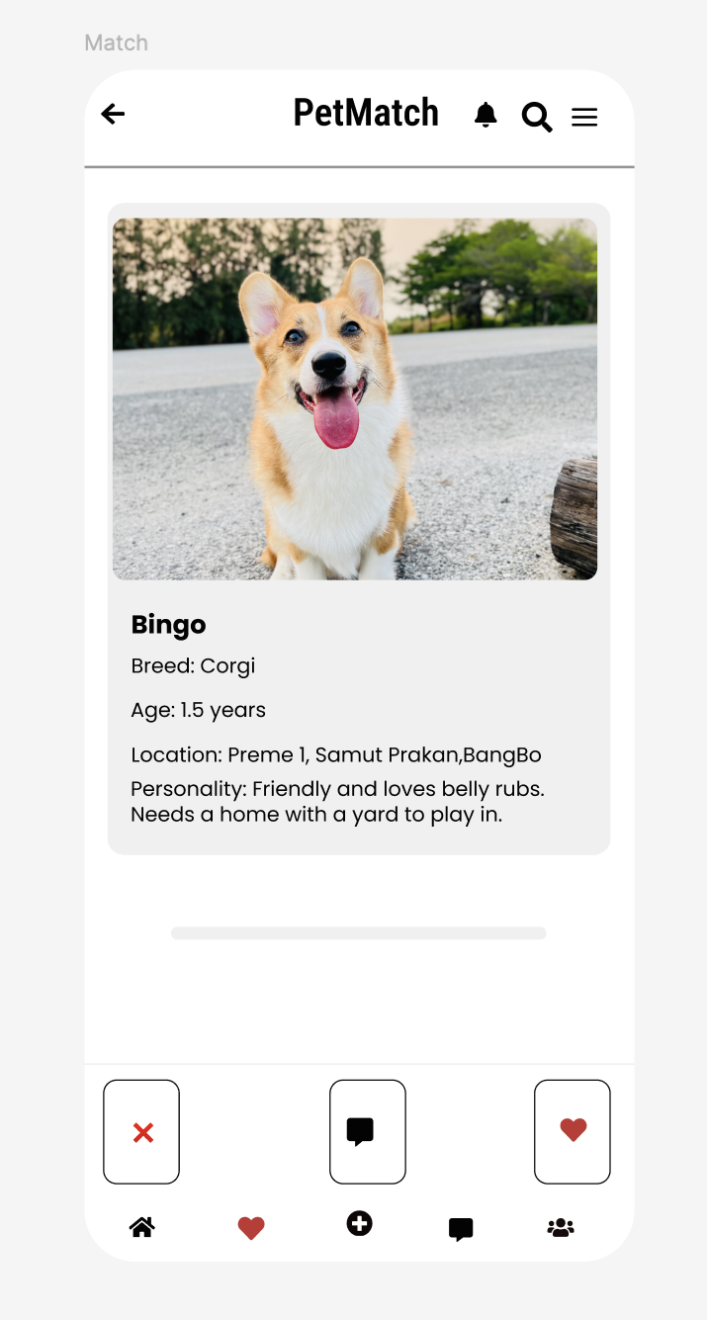
HF prototype of main features (2)
Search button
Return Button
Notification Button
Profile button
Pet Profile
Pet Details
Chat box button
Dislike
Add the pet to the favorites
Home Button
Friends and followers
Find match button
Create post button
Chat inbox button
ID:6622085
Name: Min Htet

Slide 10
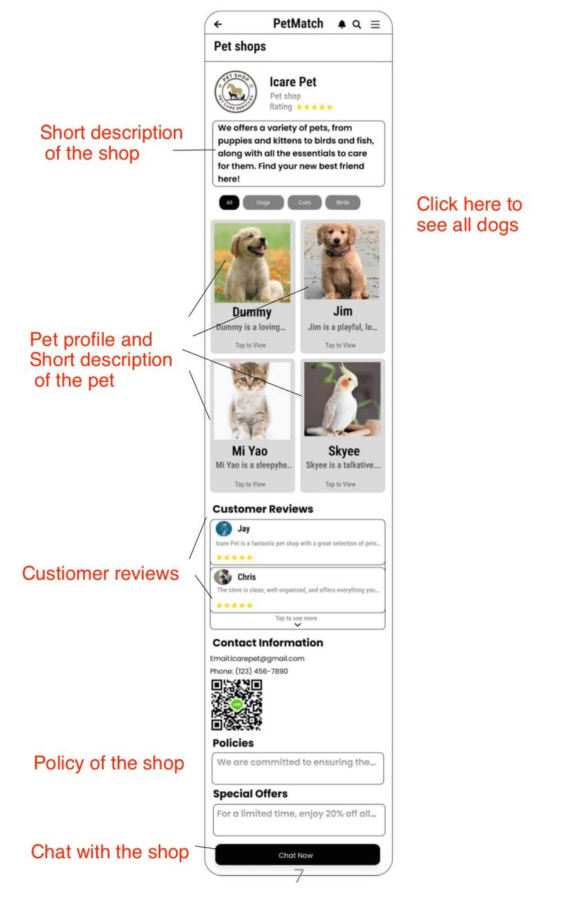
HF prototype of main features (3)
Short description
(Creator ID and Name)
Pet shop details
(6530289 and Sai Oum Maing)

Slide 11
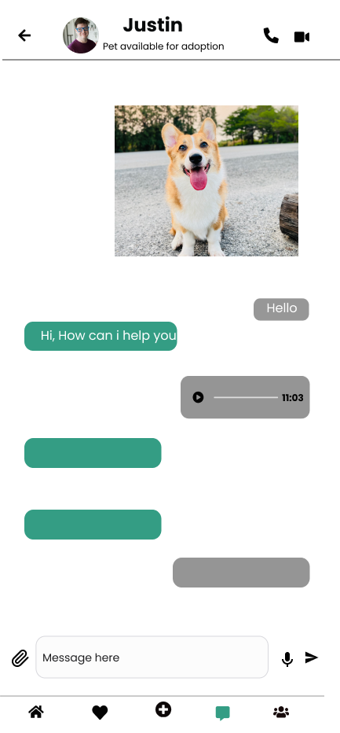
HF prototype of main features (4)
User image
User name
Return Button​
Vd-call
Ph-call
Image
message
Message box
Voice
Attachment button
Send
Home Button​
Friends and followers​
Find match button​
Short description
(Creator ID and Name)
Create post button​
Chat inbox button​
Chat Interface
6520102
Aung Bhone Naing

Slide 12
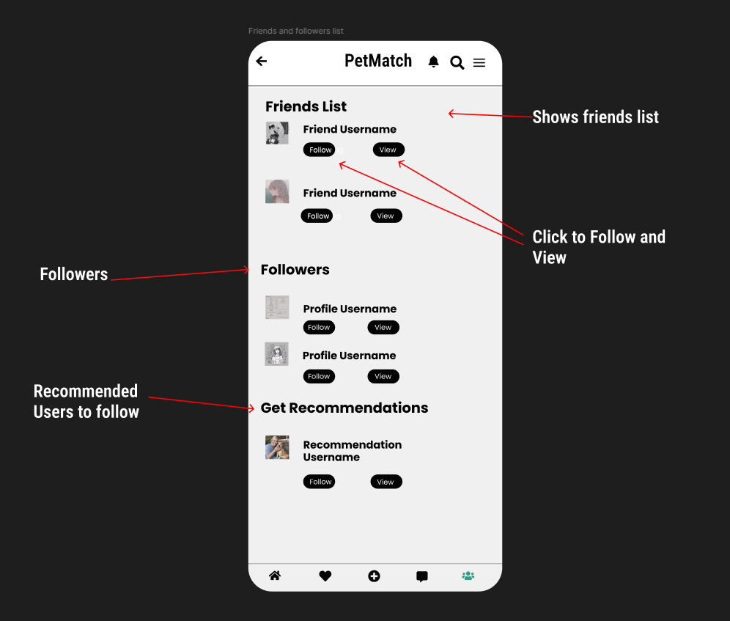
HF prototype of main features (2)
Friends and followers list
6530198
Heang Mengtry
Short description
(Creator ID and Name)

Slide 13
Assignment: Create interaction in Figma
60 mins
Objective
To be able to use Figma application to create the interaction in the final project.
Instructions
Use Figma to create the interaction in your project.
Once finished, insert the picture of the overview of prototype in your worksheet.
Insert the link to your prototype in Figma in your worksheet too.

Slide 14
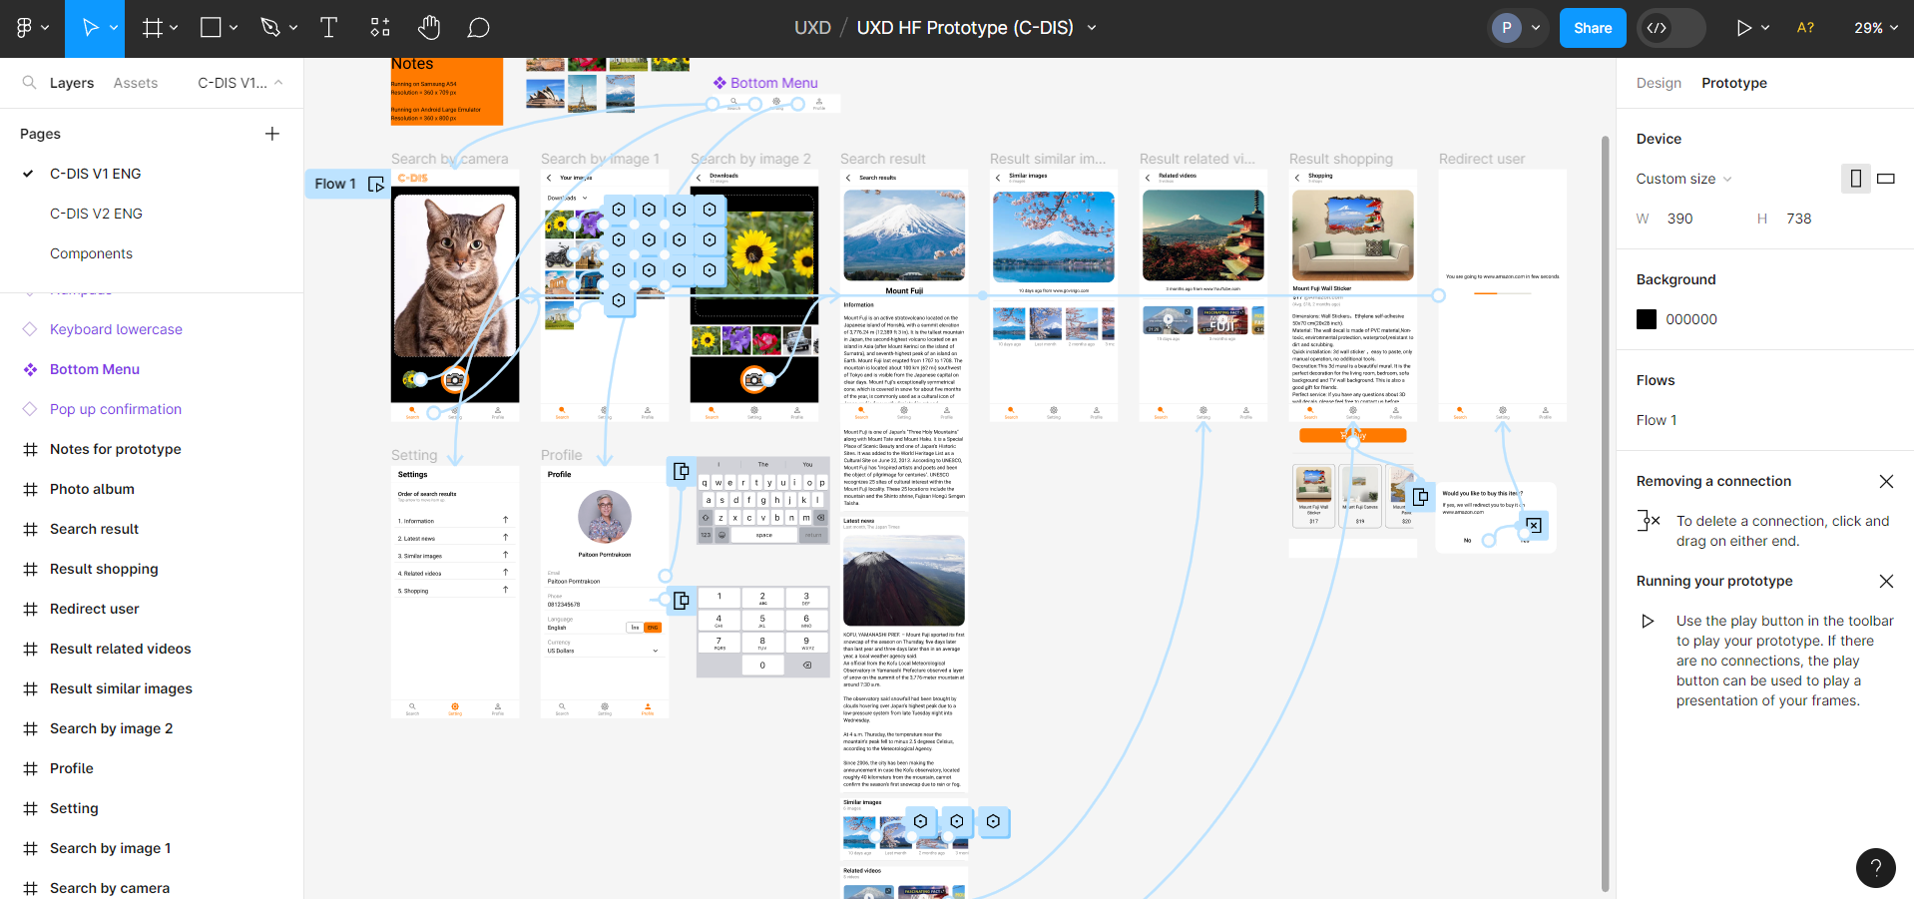
Interaction (example)
Figma Link: https://www.figma.com/proto/tDirrIUiDSjhYPTBwDhRAE/UXD-HF-Prototype-(C-DIS)?type=design&node-id=8-121&t=FE8wWgU6shf3xwEU-1&scaling=scale-down&page-id=0%3A1&starting-point-node-id=8%3A121&mode=design

Slide 15
Assignment: Create interaction in Figma
Grading Criteria
0 = Blank, or link to Figma is not accessible.
1 = Interactions of less than half of the main objects are created.
2 = Interaction of more than half of the main objects are created.
3 = Interactions of all main objects are created.

Slide 16
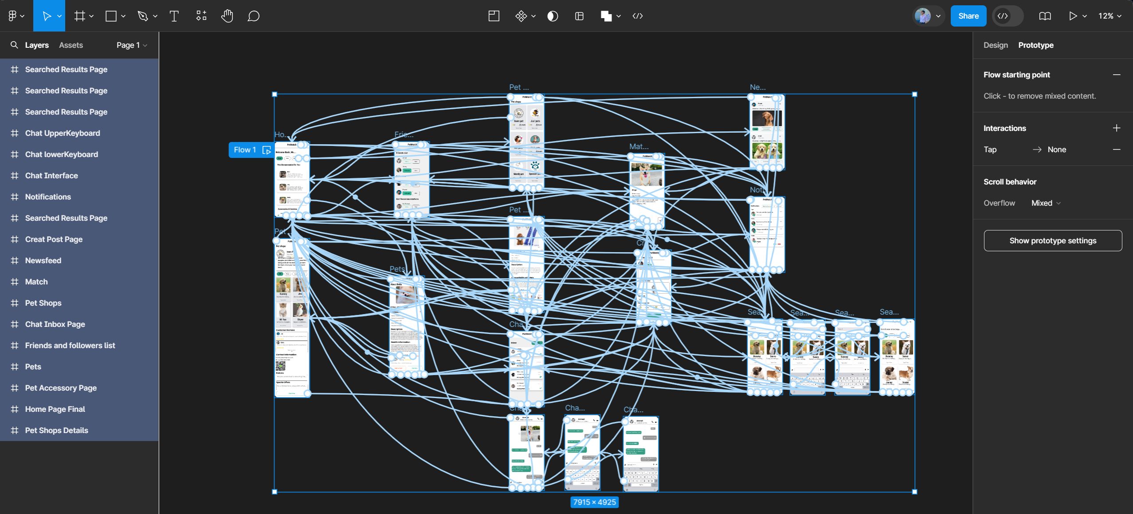
Interaction
Figma Link: https://www.figma.com/proto/qMTwmySd3fl0a8Zm7kjLMP/Pet_Match_Interactions?node-id=3-209&node-type=frame&t=caSNq6vlw13Y7IgB-1&scaling=scale-down&content-scaling=fixed&page-id=0%3A1&starting-point-node-id=3%3A209
Notes:
(3) Ok

